Slide 1
BANK APPLICATION Guided By-Dr.Rajesh Upadhyay
TEAM MEMBERS
Dhananjay Kumar 45120367
Akshita Hedaoo 45120176
Anushka Verma 45120151
Gursabiha Miranshah 45120362
Kunil Kothari 45120045
Preksha Gandhi 45120222
Richa Priya 45120103
Sakshi Saxena 45120271
Suprabha Kundu 45120286
Himadri Biswas 45120204

Slide 2

DEMERITS OF BRANCH BANKING
- Delays in decision making
- Danger of Mismanagement
- Expensive
- Lack of Initiatives
- Regional Imbalance

Slide 3
ONLINE BANKING GUI
ADVANTAGES DISADVANTAGES
For Consumers: For Consumers:
Privacy some are uncomfortable to provide credentials on internet
Online service 24*7 knowledge on using internet is necessary
Search of any bank accessible
Accessible from anywhere

Slide 4
WORKING
Storing personal details on database servers
After you login with credentials , application searches in the database.
If credentials gets matched then you successfully gets logged in
After login , user can do basic user processes and perform various activities

Slide 5
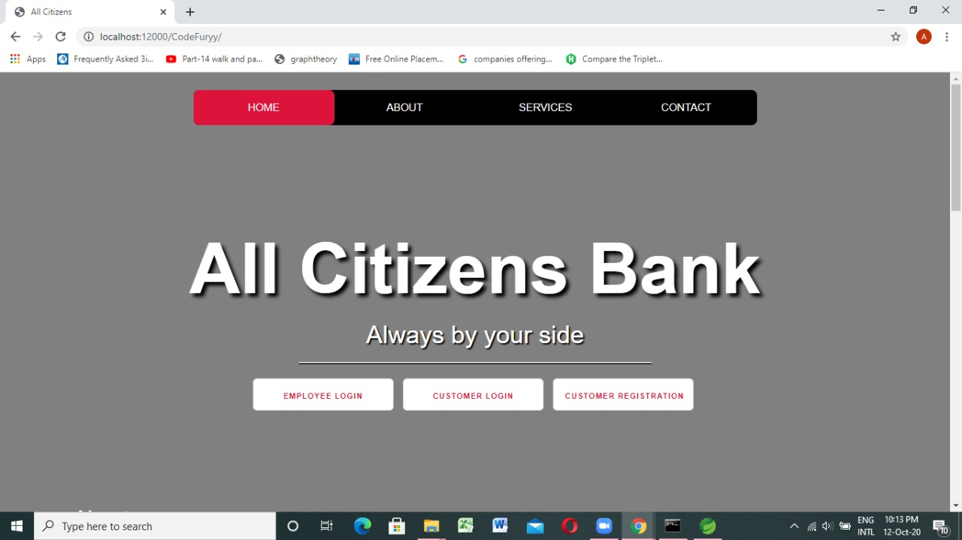
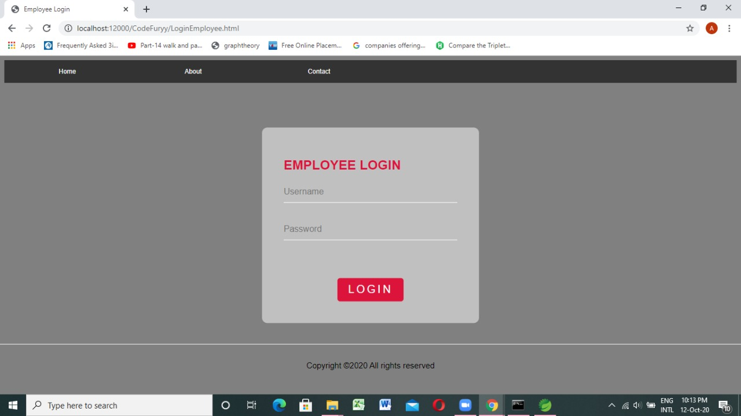
PROJECT WORKING SCREENSHOTS

Slide 6
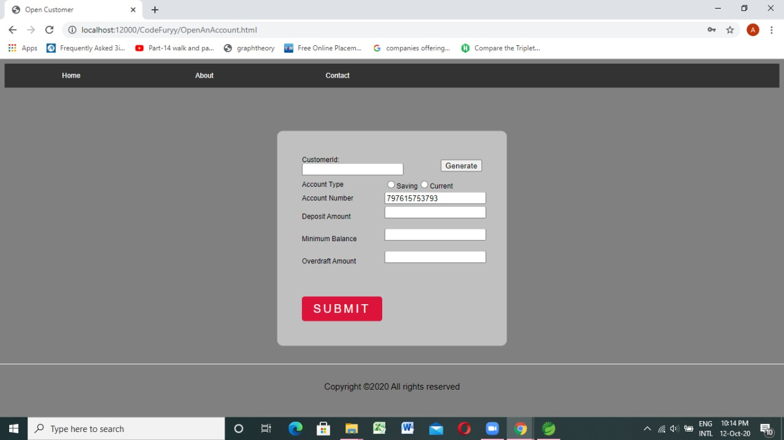
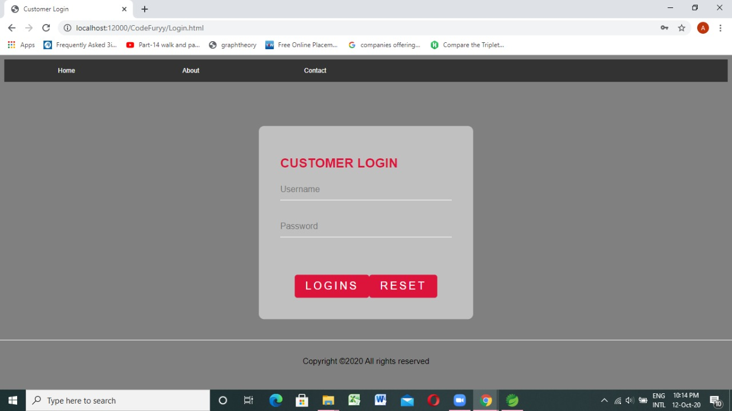
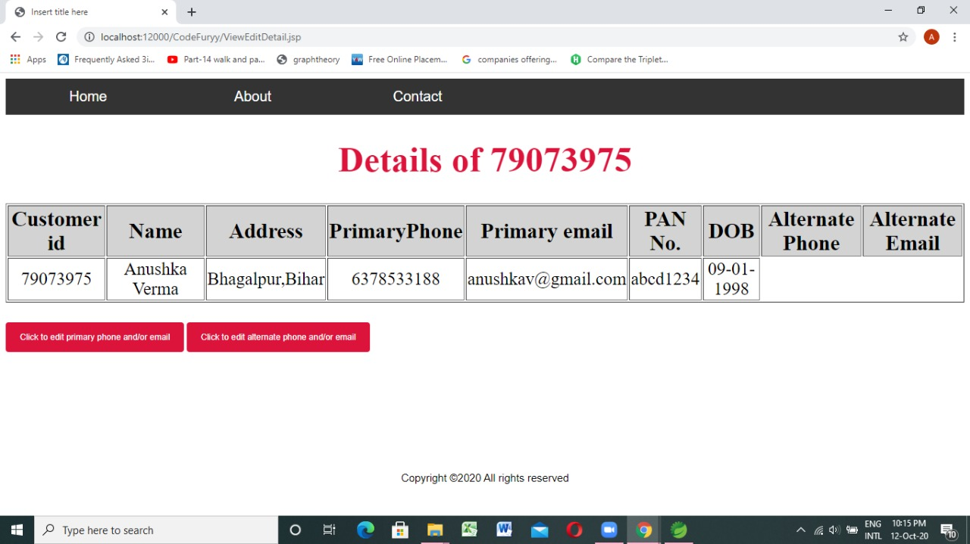
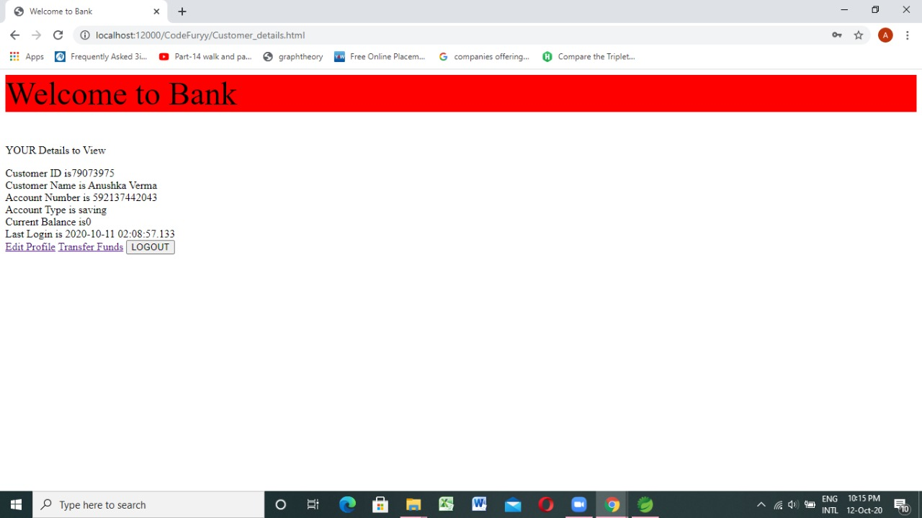
PROJECT WORKING SCREENSHOTS

Slide 7
SOFTWARES AND LIBRARIES USED
Operating System-windows 7 and above
linux
System must have JAVA JDK 1.8 or above
Database server Derby 10.13.1.1
Spring tool suite
Tomcat server version 9.0
TECHNOLOGIES USED: JAVA,HTML,CSS,JSP/Servlets

Slide 8
FUTURE IMPROVEMENTS
JAVA 8 features can be included.
Spring MVC can be used
Node JS and Angular can be used to implement more user friendly features.

